Slide 1


BUSINESS CHALLENGE: EDA AND SQL DISCOVERING THE IMPACT OF VIRTUAL REALITY ON EDUCATION
BY JULIA NUSS
Background image generated with AI

Slide 2
QUICK OVERVIEW
THE DATA
Dataset: Impact of Virtual Reality on Education from Kaggle (https://www.kaggle.com/datasets/waqi786/impact-of-virtual-reality-on-education)
„This dataset delves into the impact of virtual reality (VR) on education, highlighting its potential to enhance learning experiences across various subjects. It encompasses data on student engagement, retention rates, and overall academic performance when VR is integrated into the curriculum.“
(Source: Waqar Ali, 2024)
WHY?
Big interest in VR in educational purposes, New Learning, wanting to gain further insights on the topics

Slide 3
THE DATASET
One CSV-File with one table
5000 rows with different Student IDs, 20 columns with information about age, subjects, continent, VR usage per week etc.
One incrementing index row (Student_ID)

Slide 4
THE GOALS
Cleaning and analyzing the Dataset
Creating a Database
MAIN: Gaining and visualizing insights about the impact of VR in education
e.g.
The distribution of VR usage in education over the world
Improvement of academical performance
Relations between IT affinity and improvement in performance
Relations to age, gender, degree
Factors like stress/motion sickness in improvement of academical performance
and more.

Slide 5
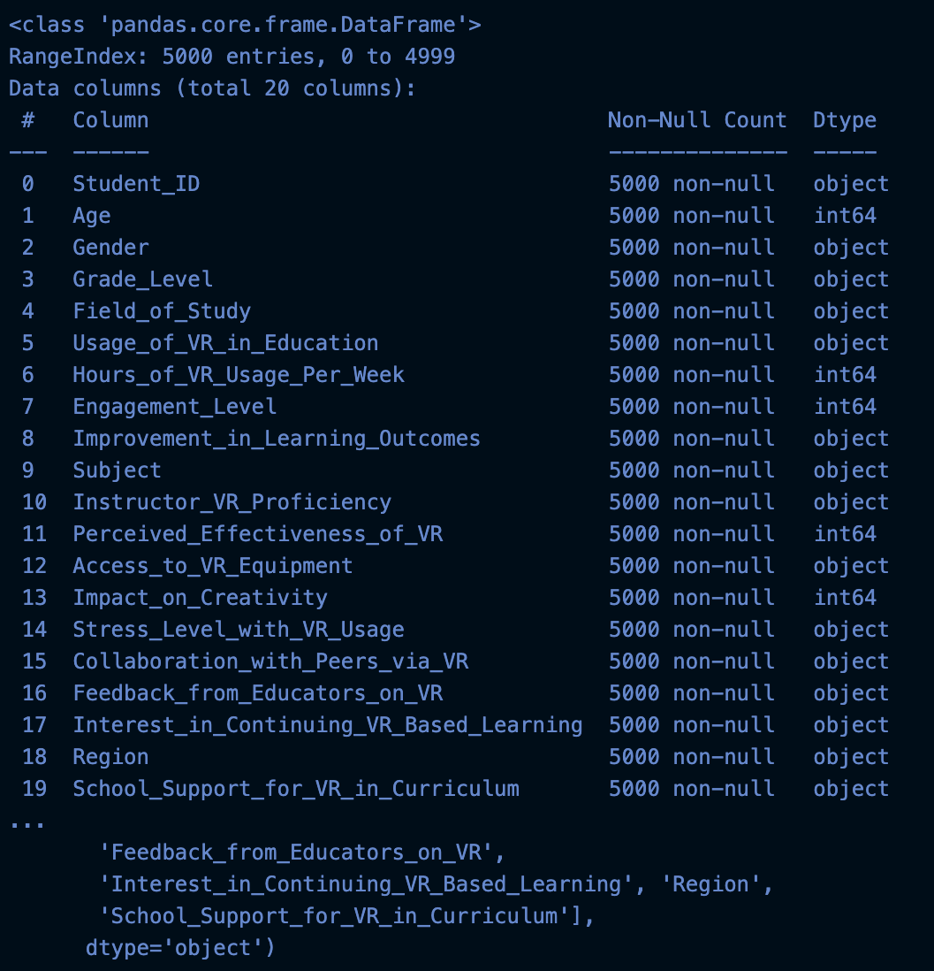
EDA

Slide 6
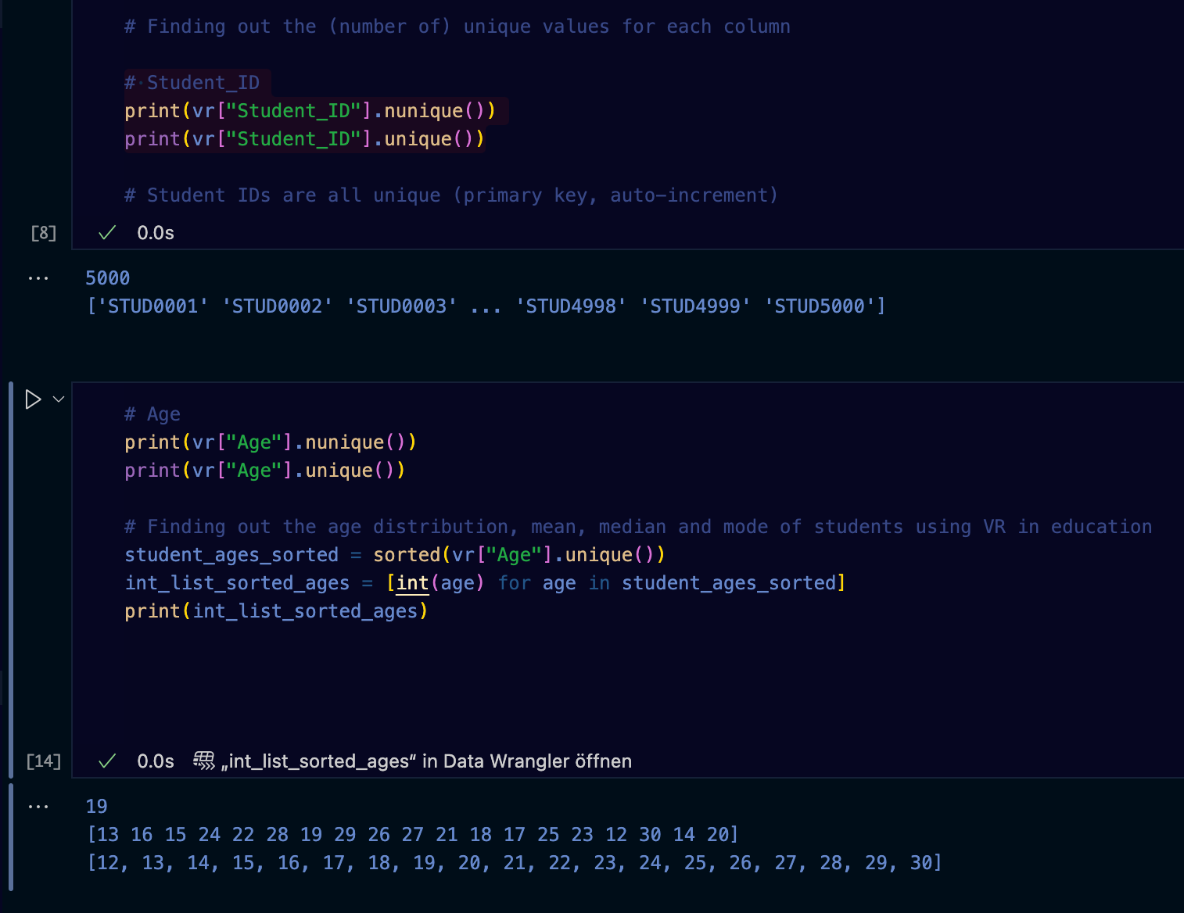
EDA

Slide 7
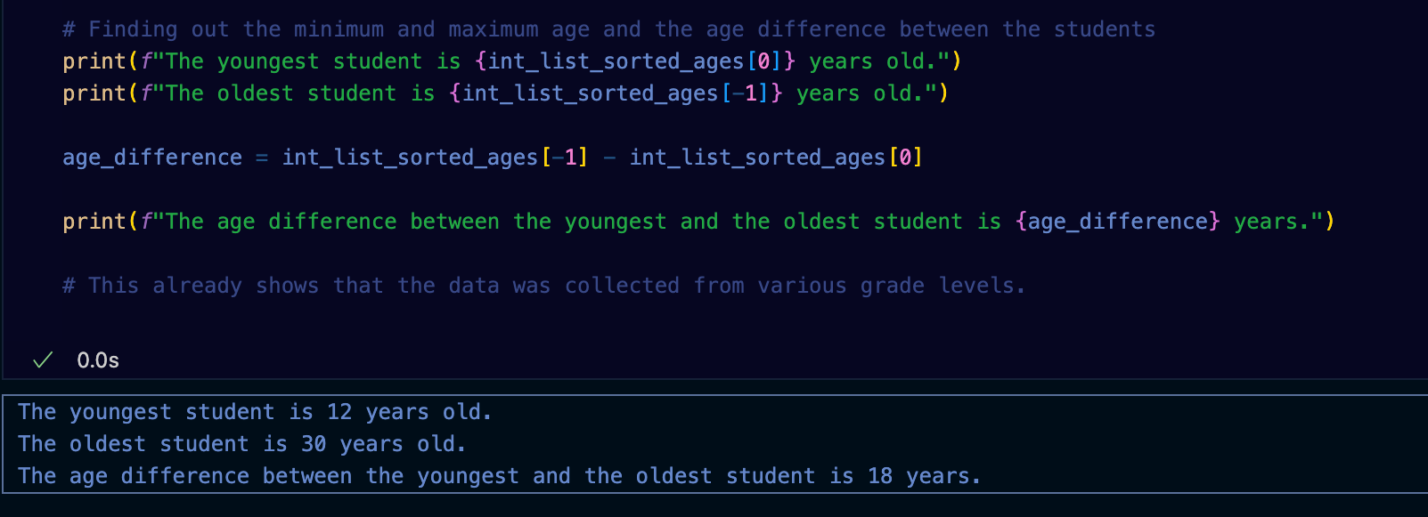
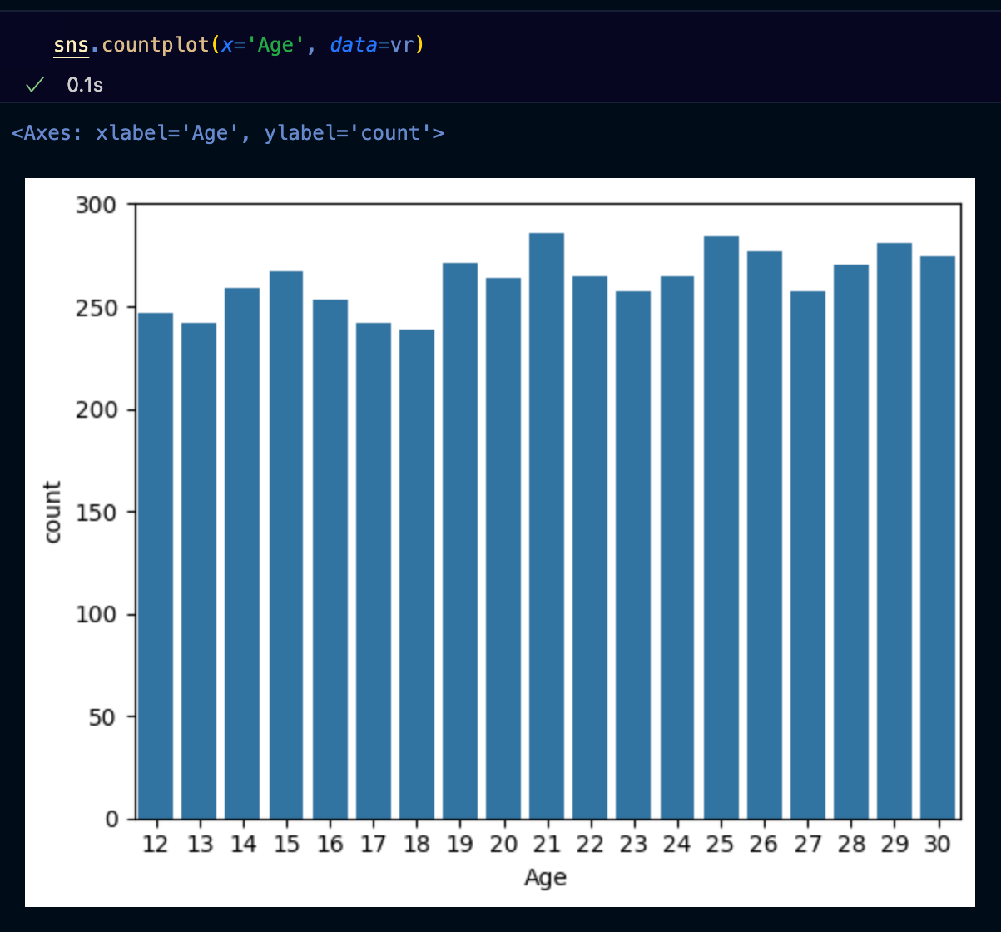
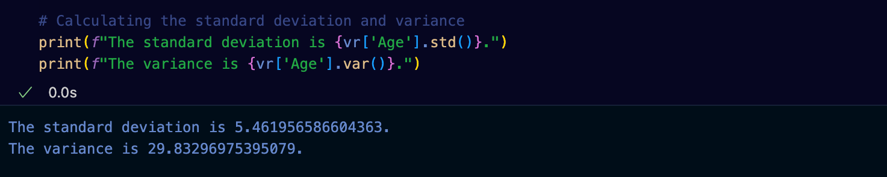

Slide 8
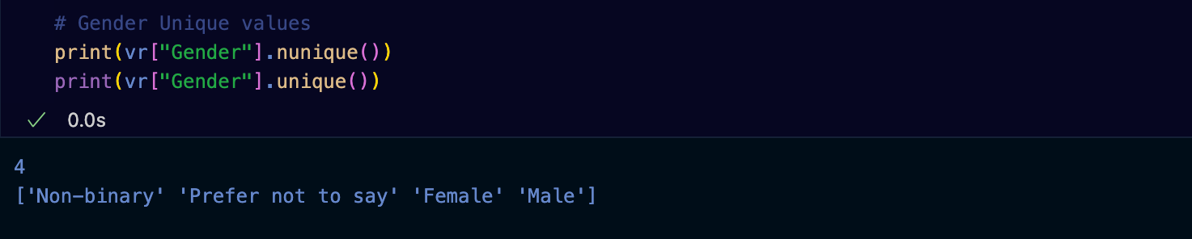
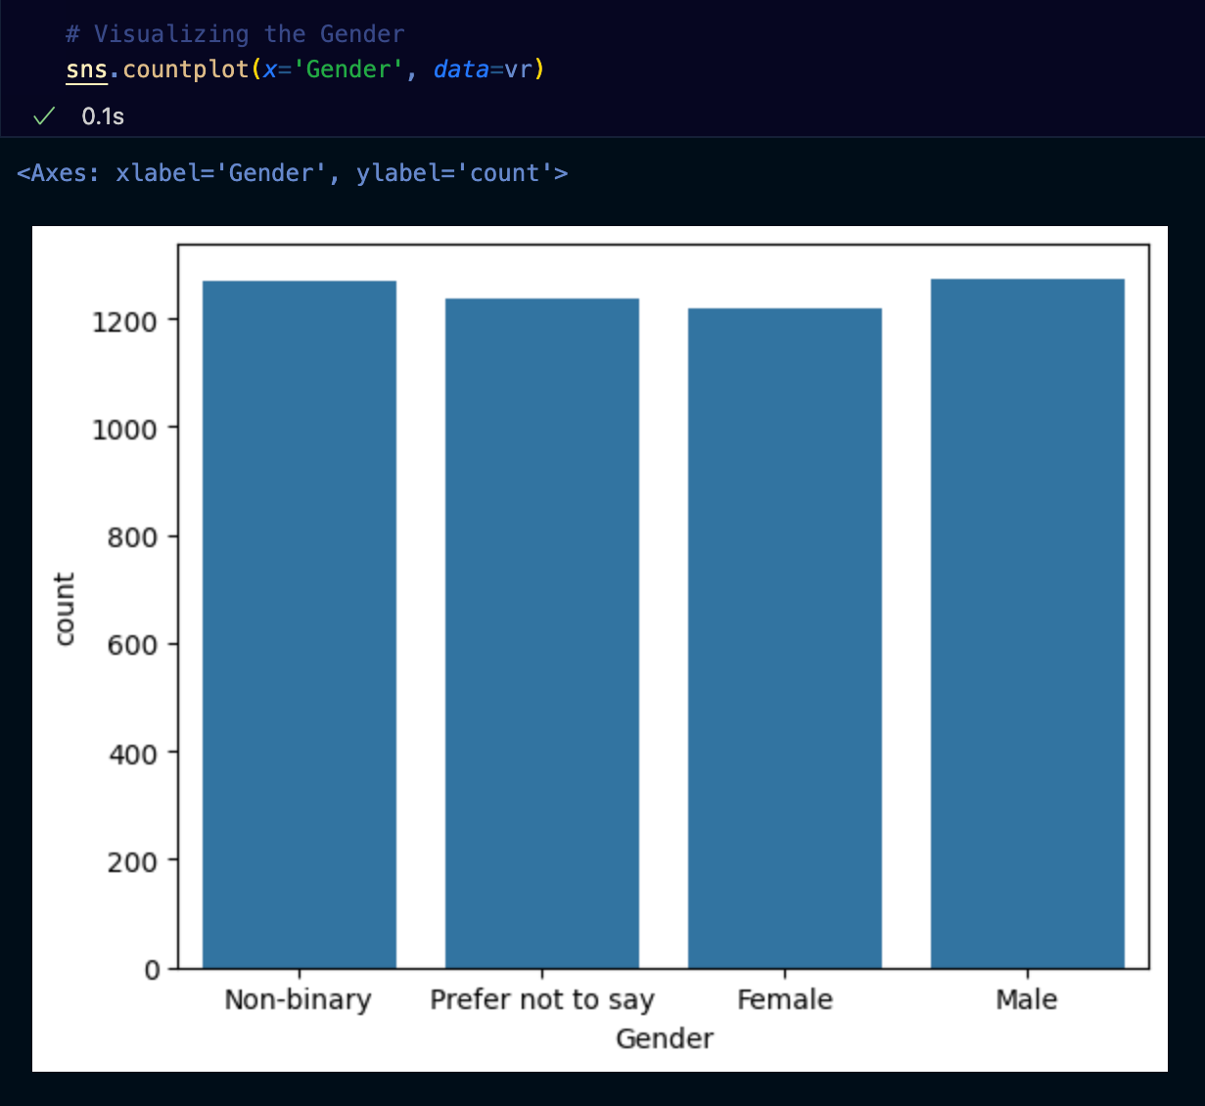

Slide 9
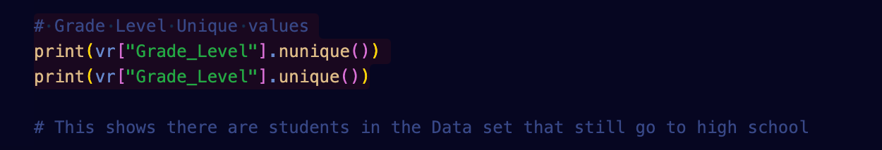
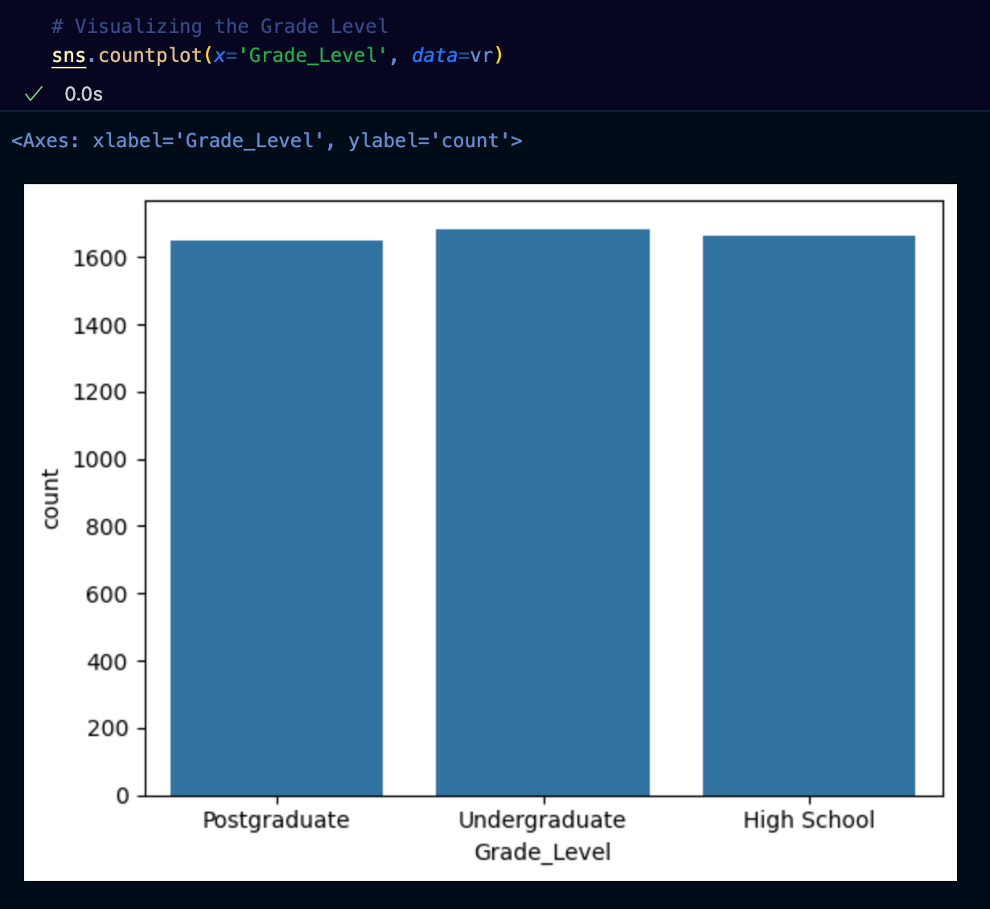

Slide 10
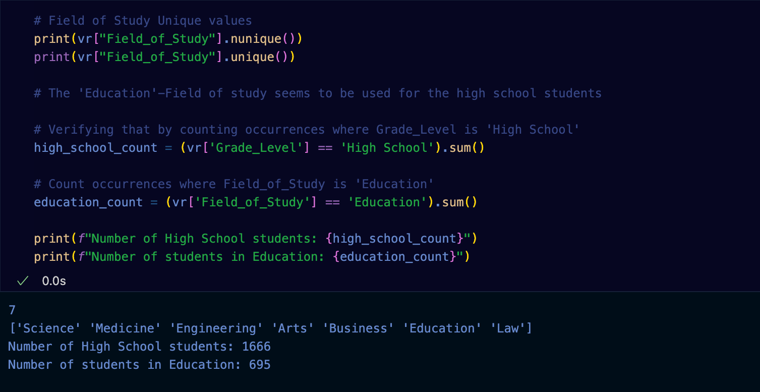

Slide 11
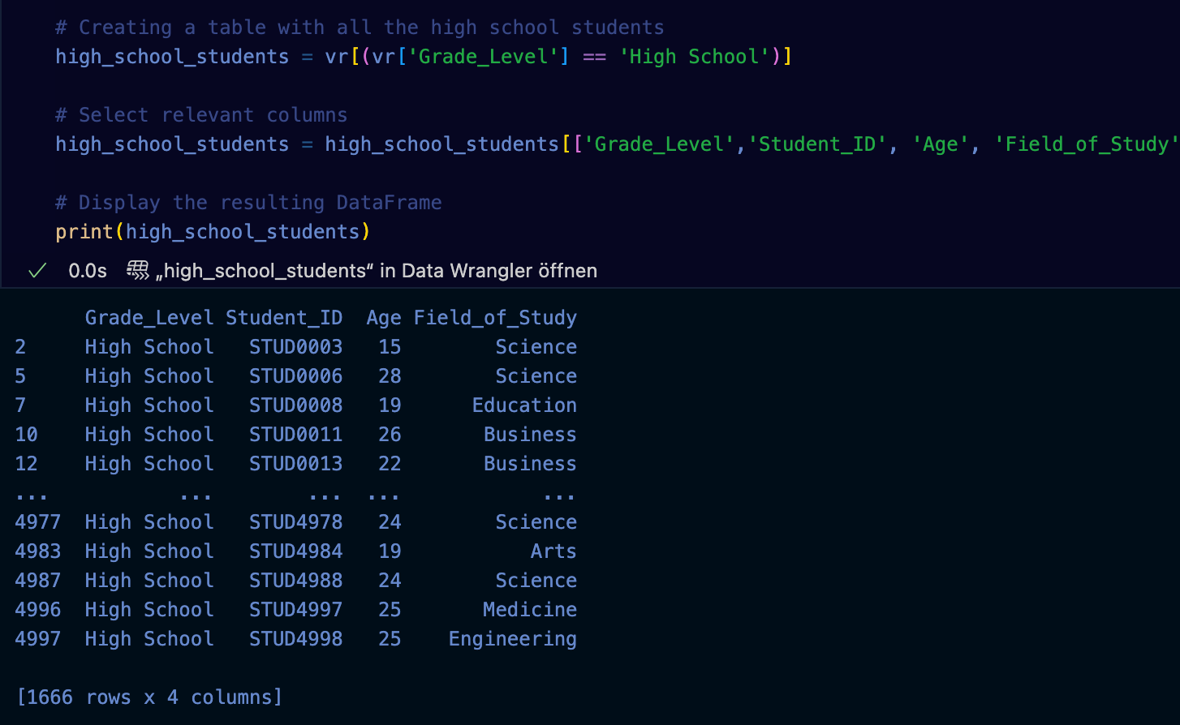

Slide 12
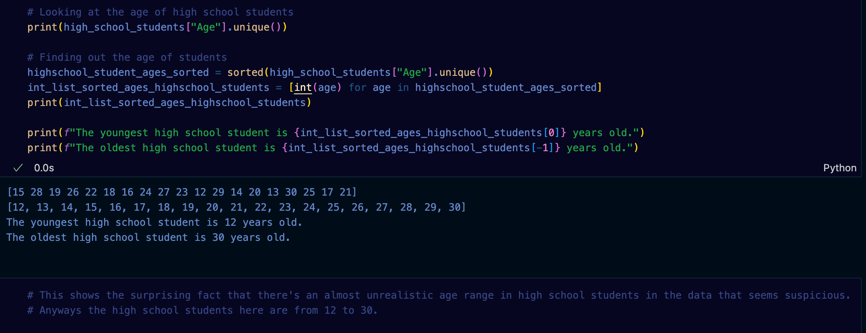

Slide 13
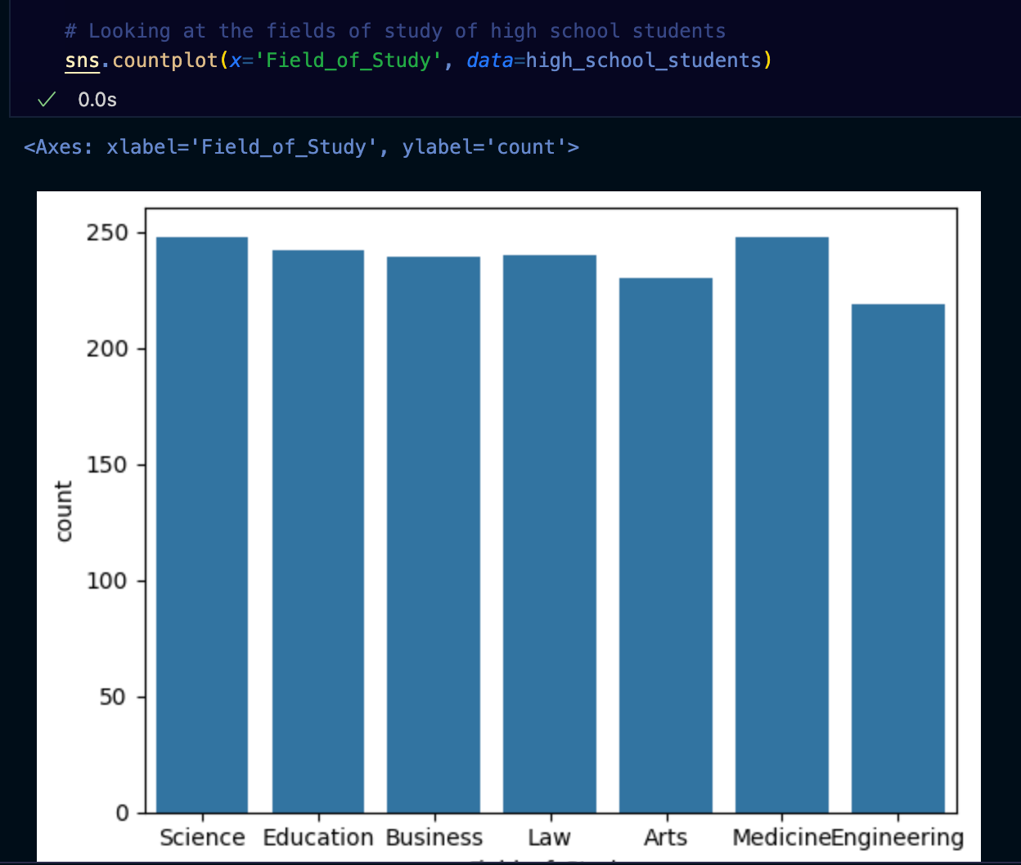

Slide 14
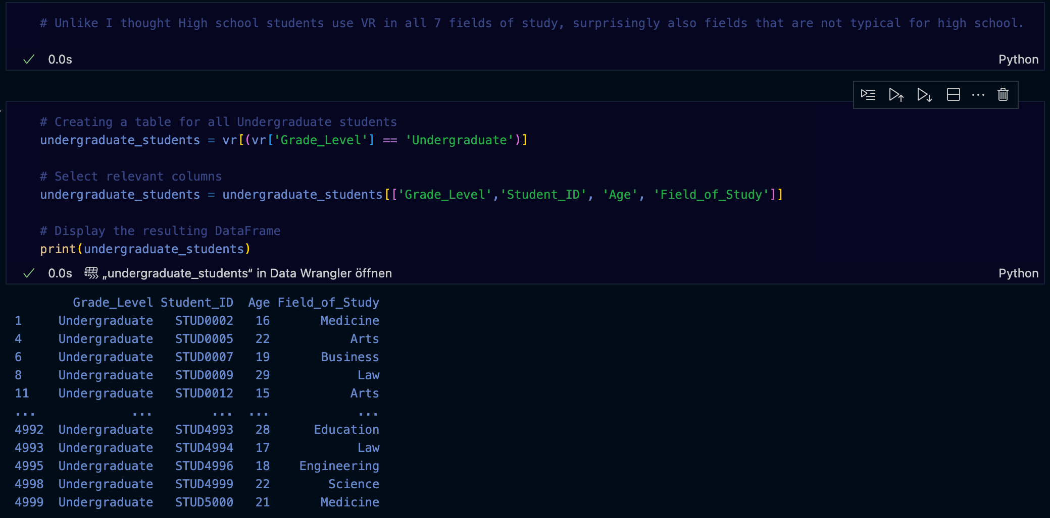

Slide 15
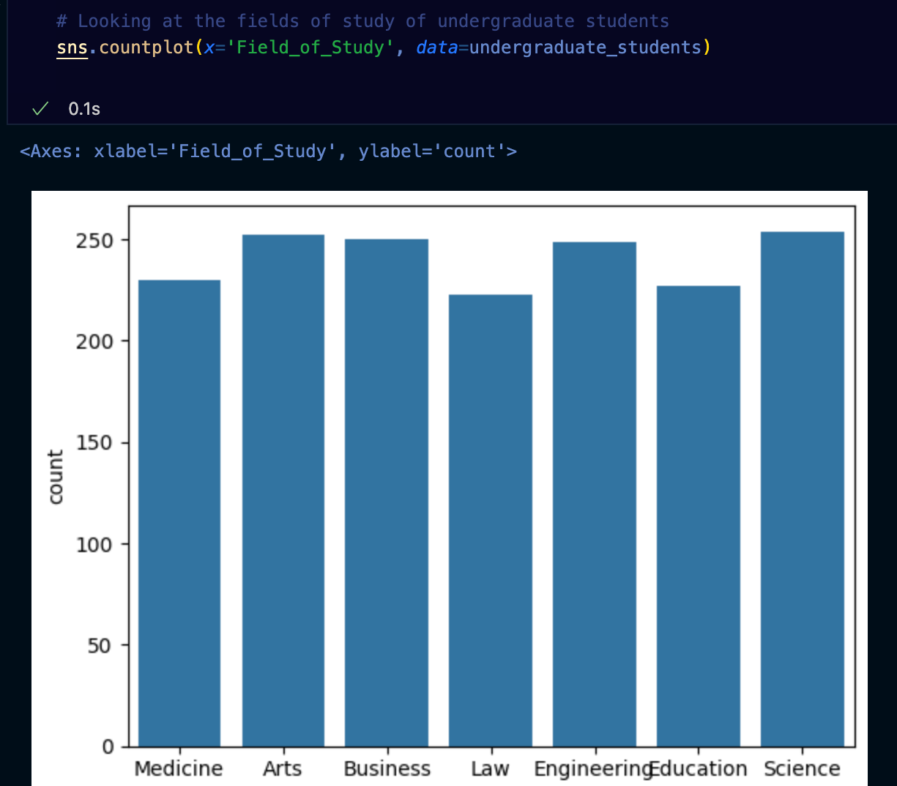

Slide 16
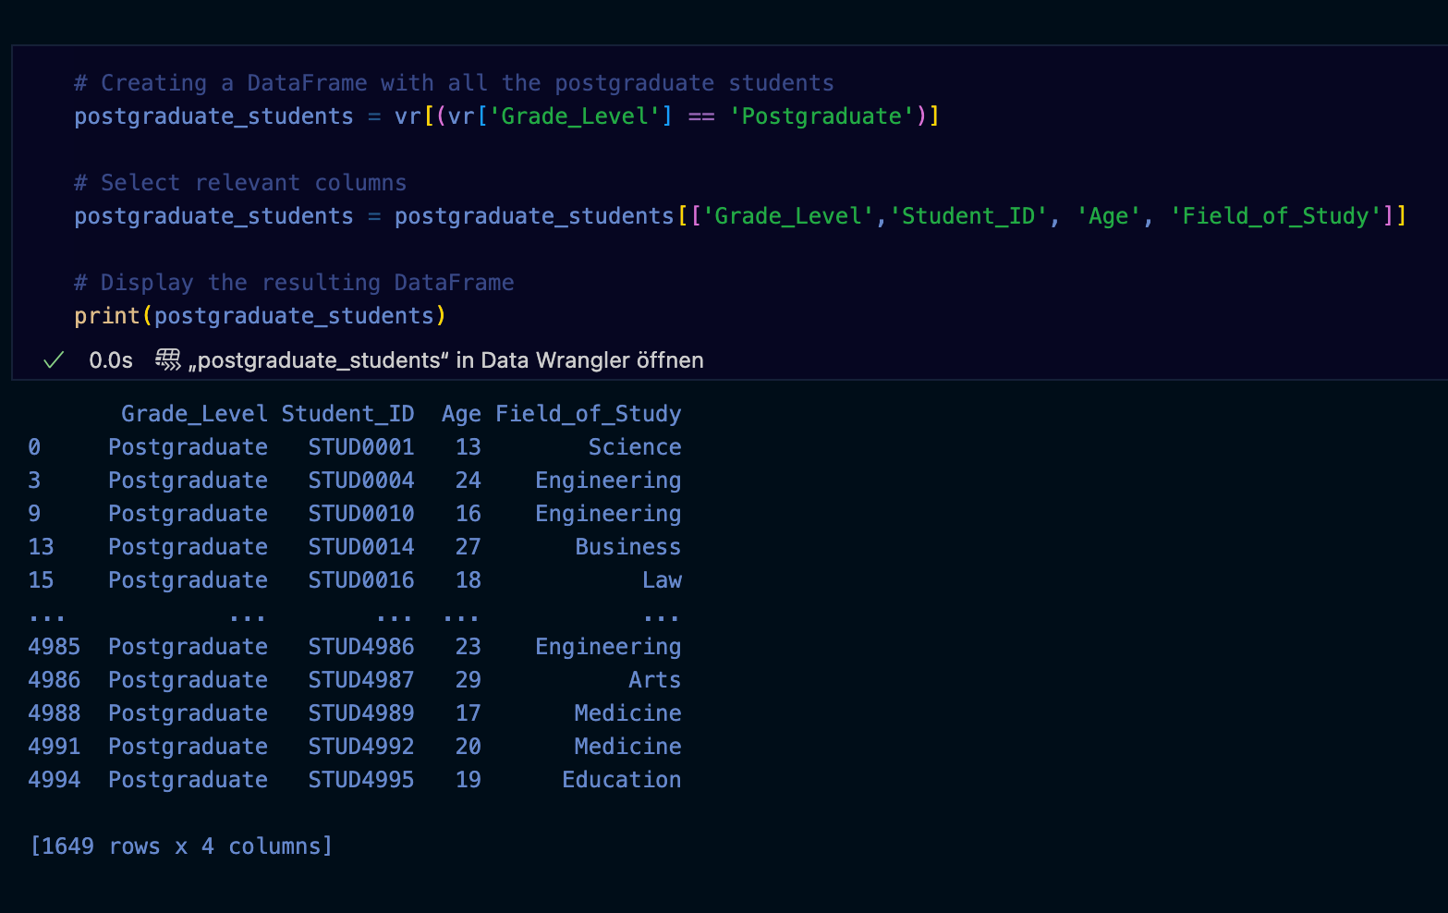

Slide 17
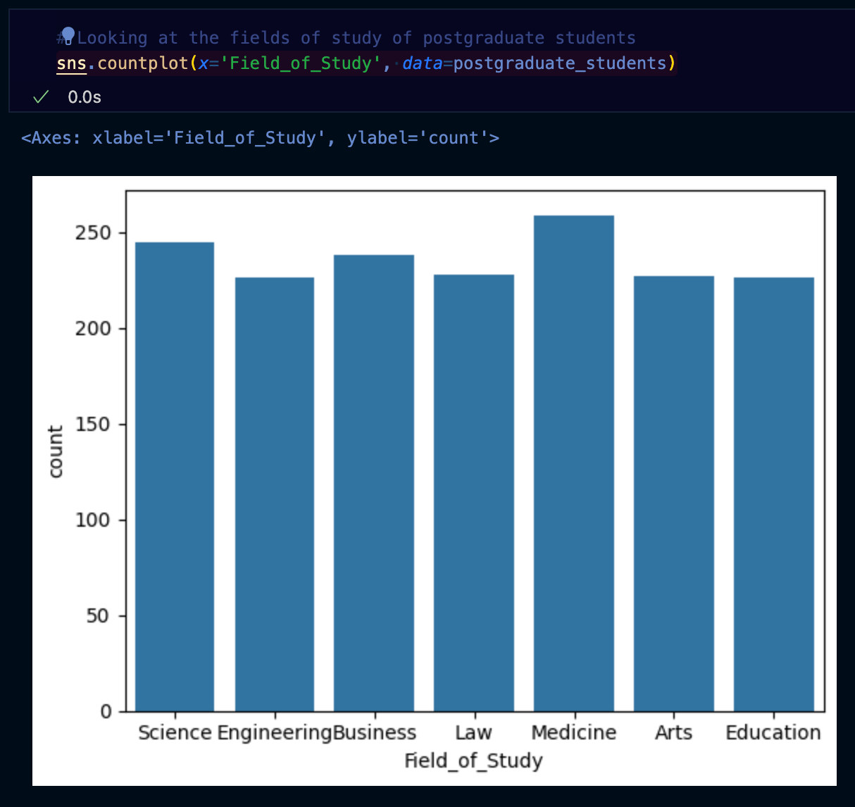

Slide 18
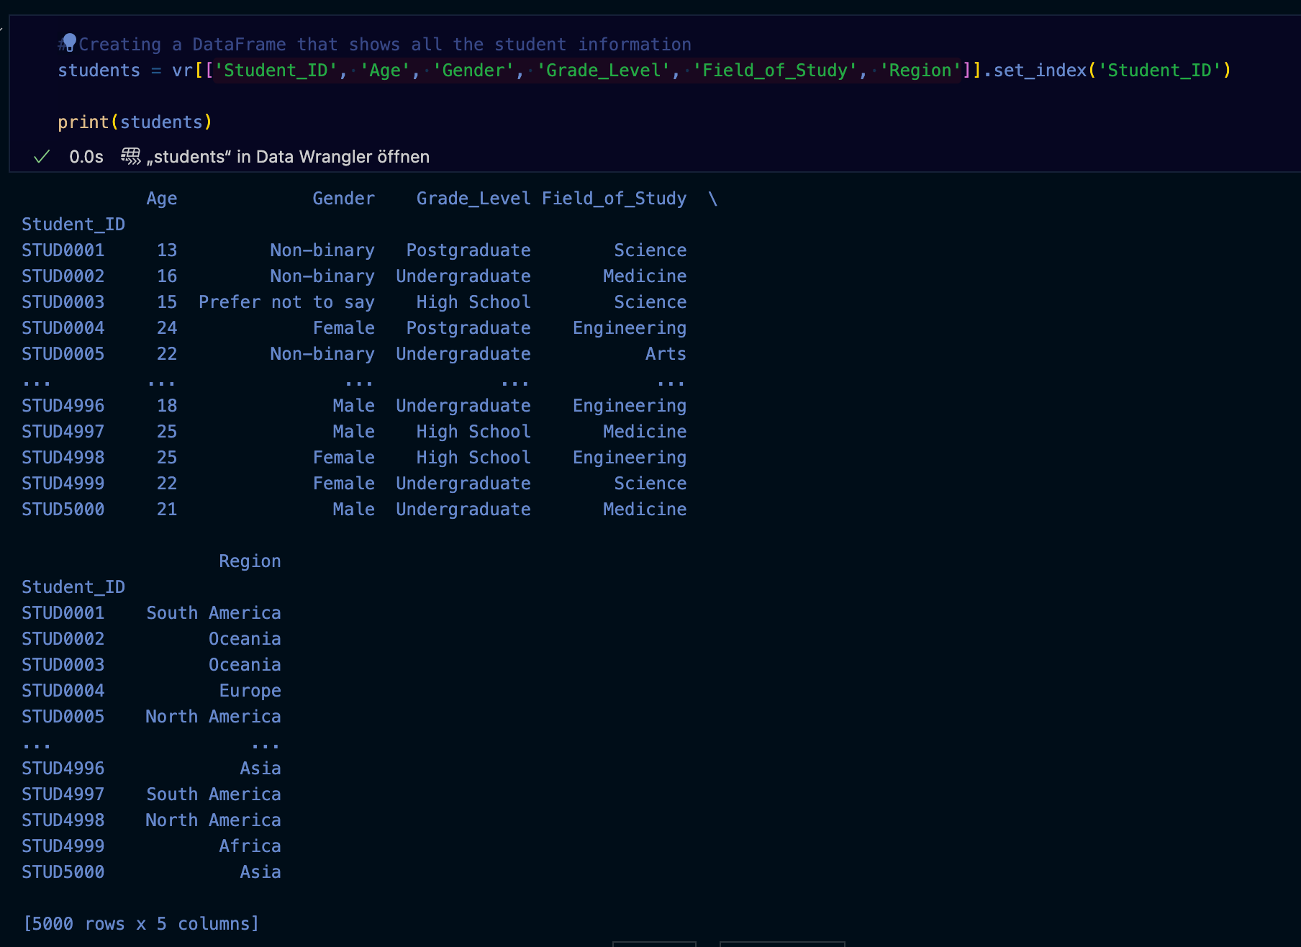

Slide 19
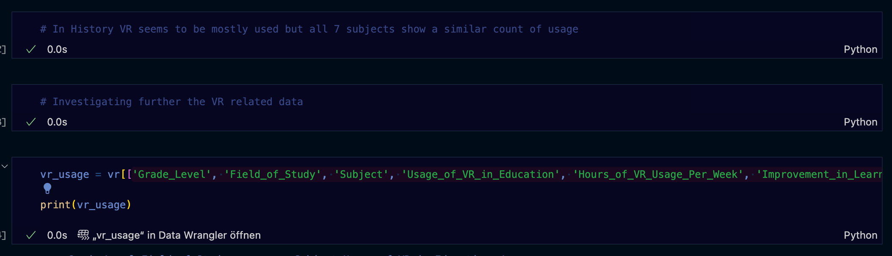

Slide 20
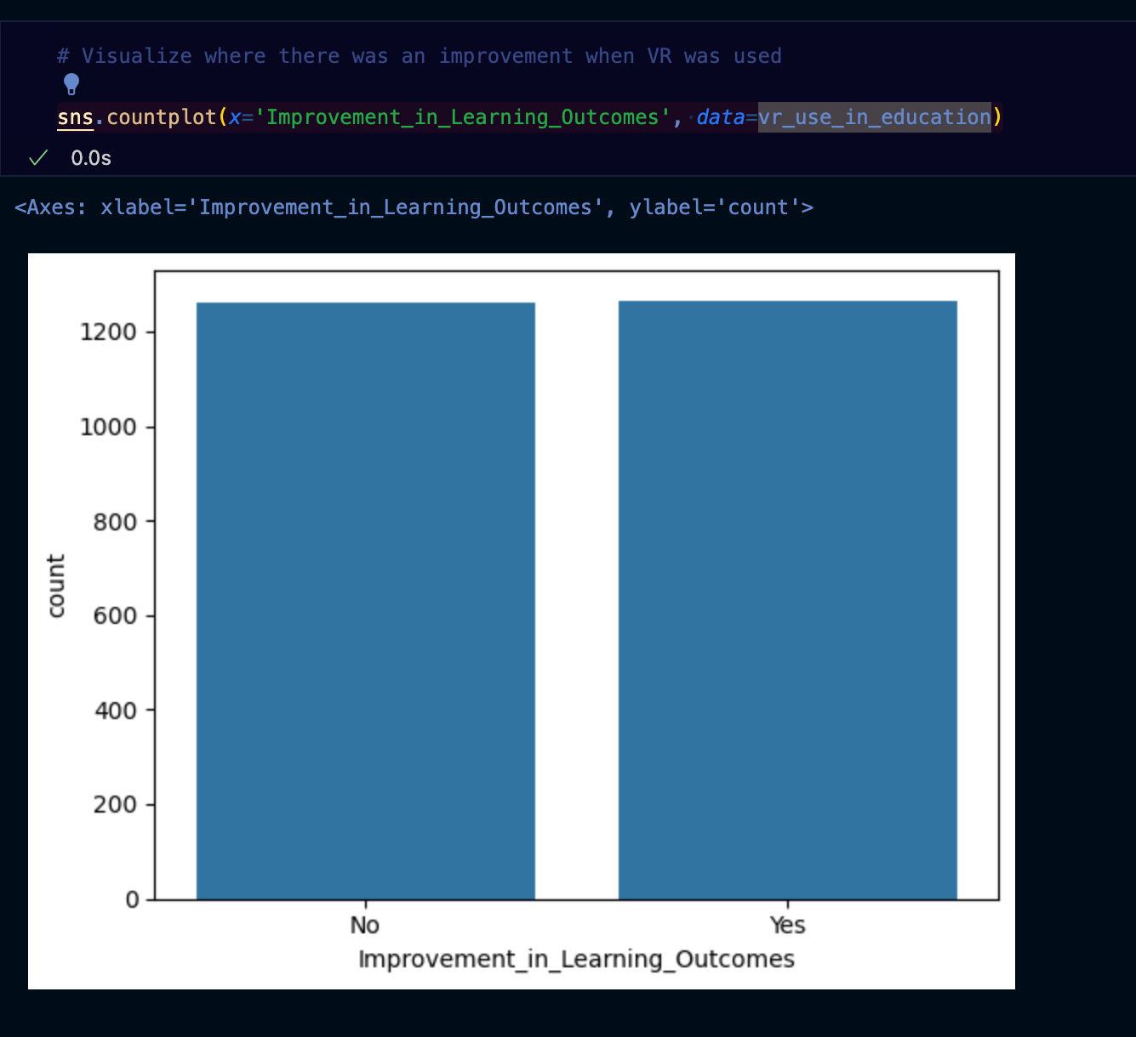

Slide 21
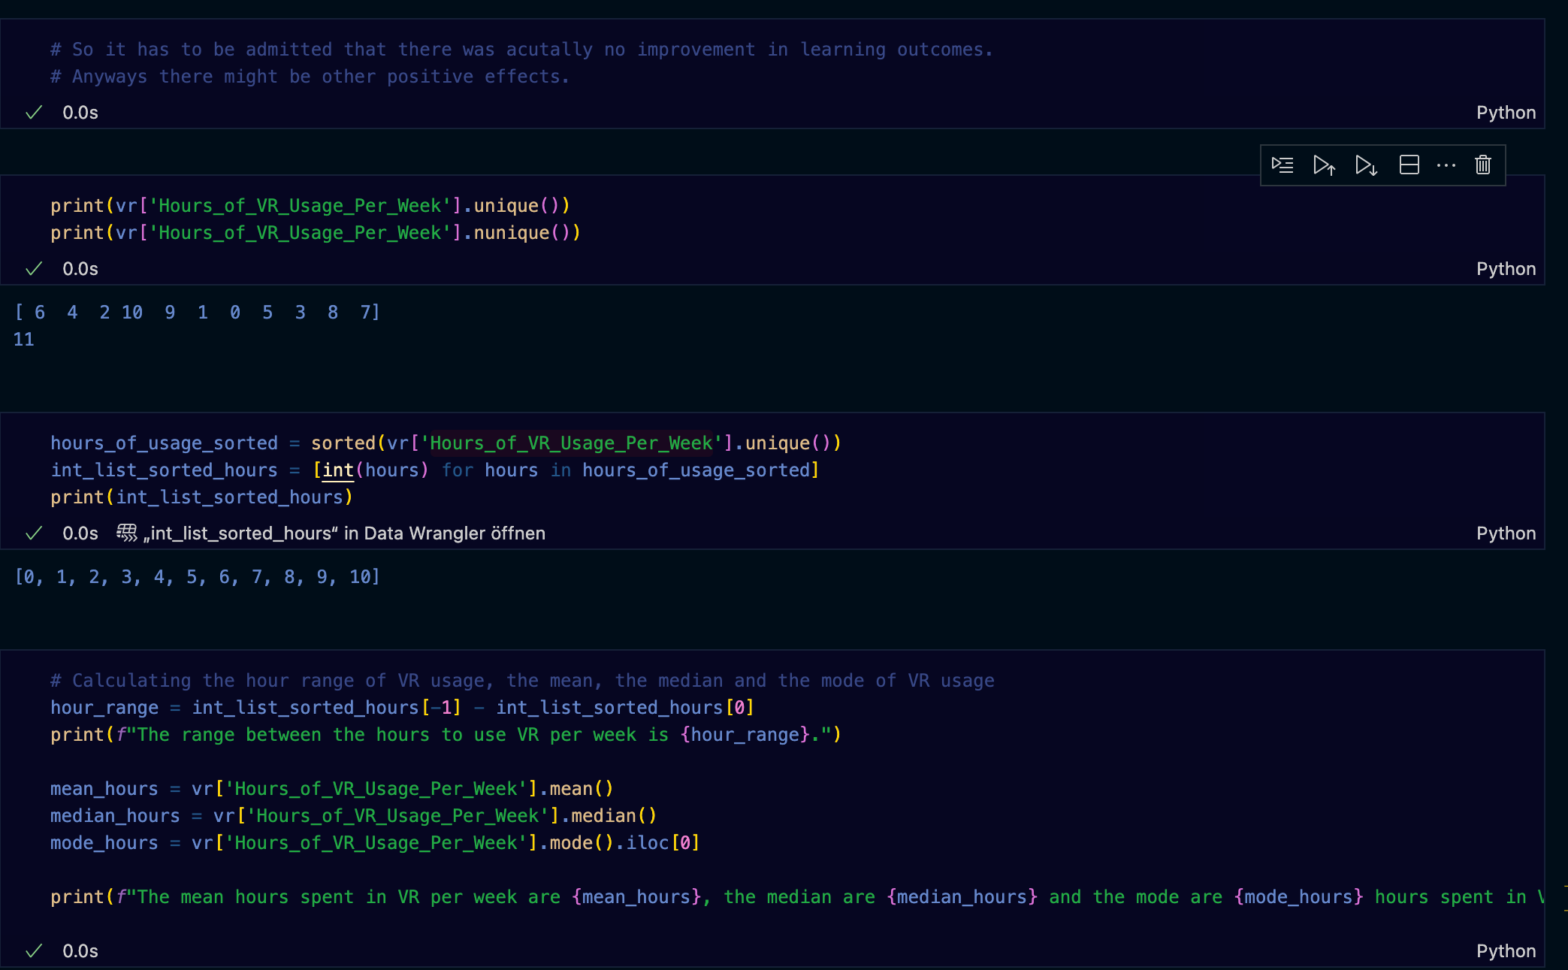

Slide 23
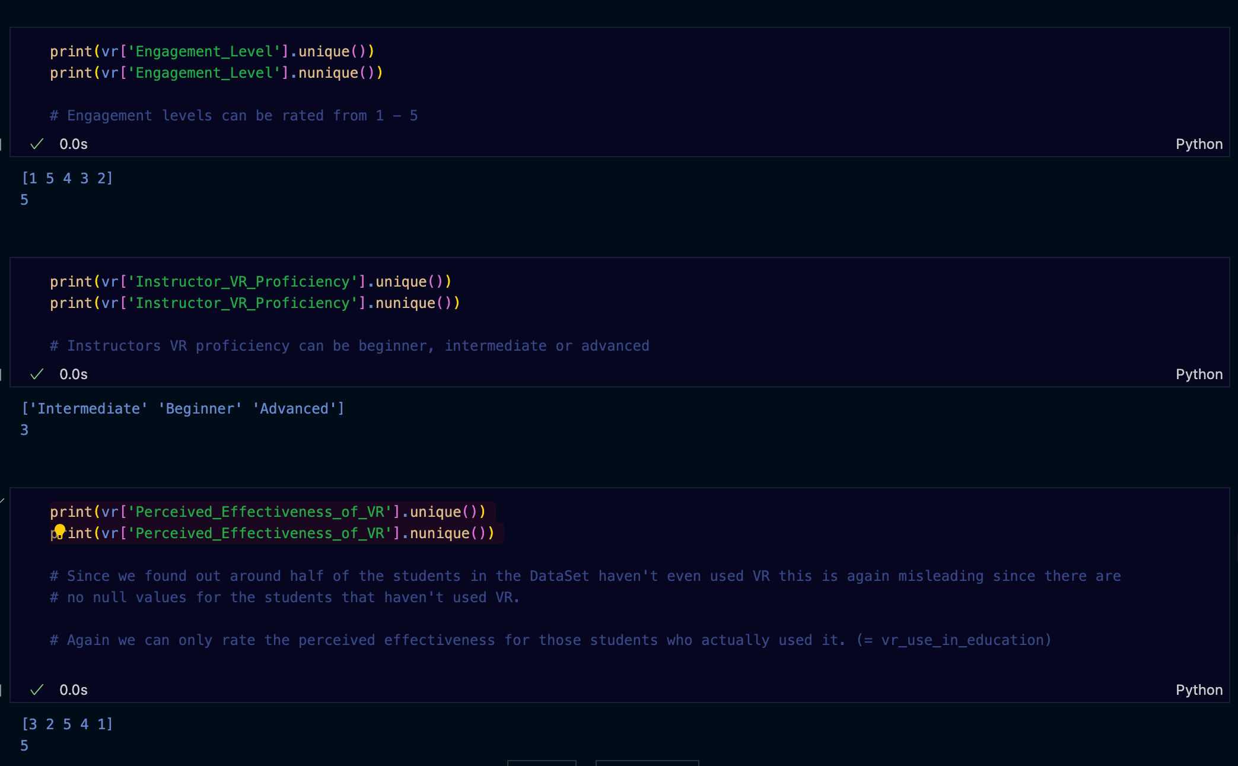

Slide 24
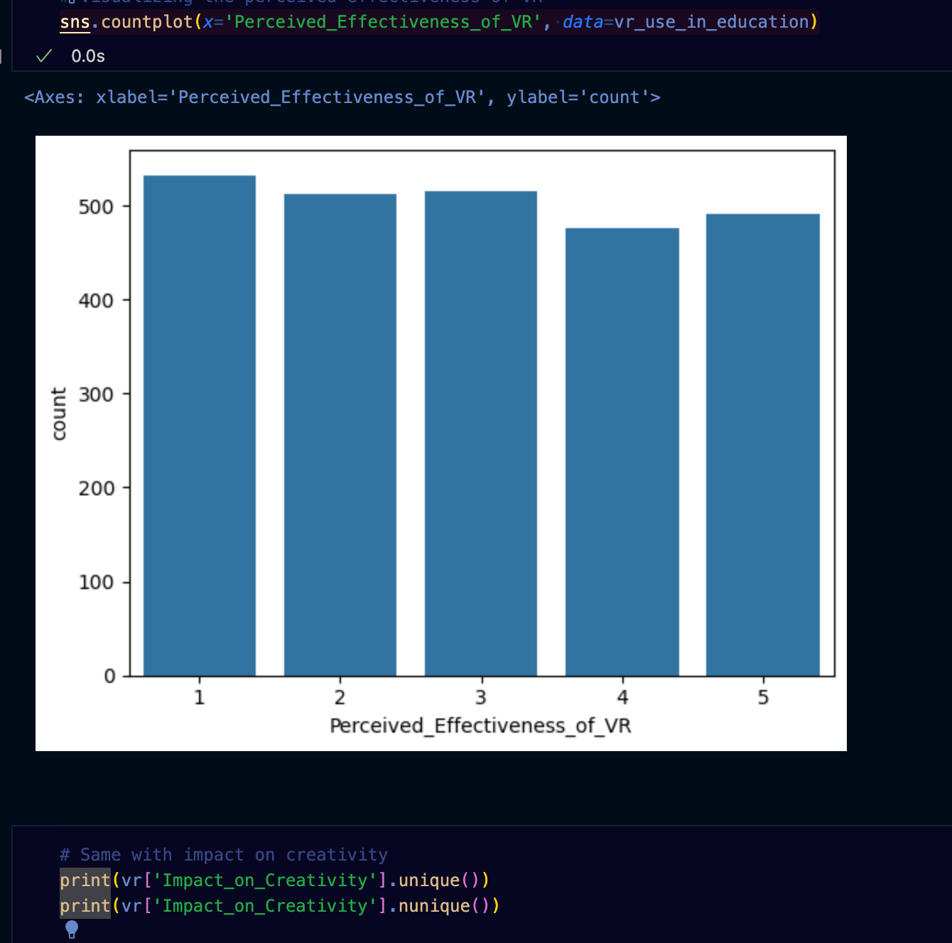

Slide 25
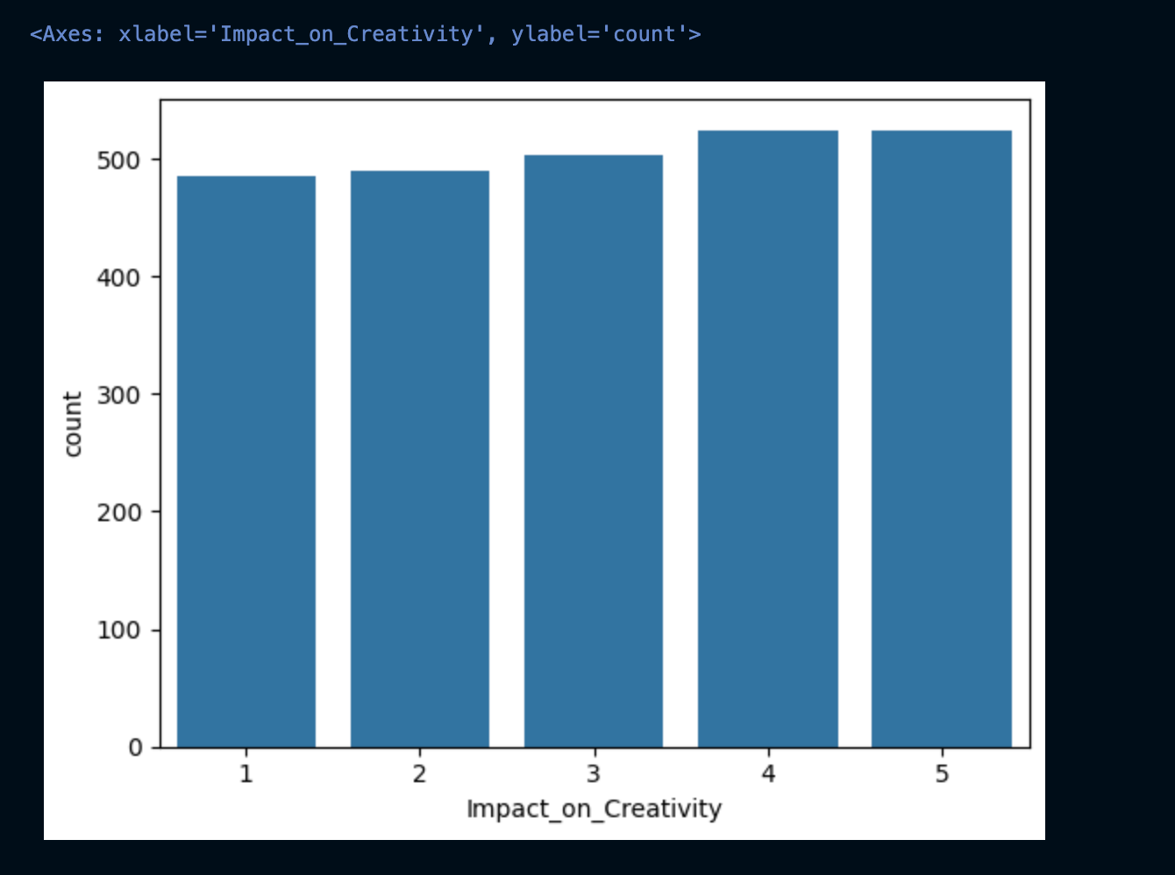

Slide 26
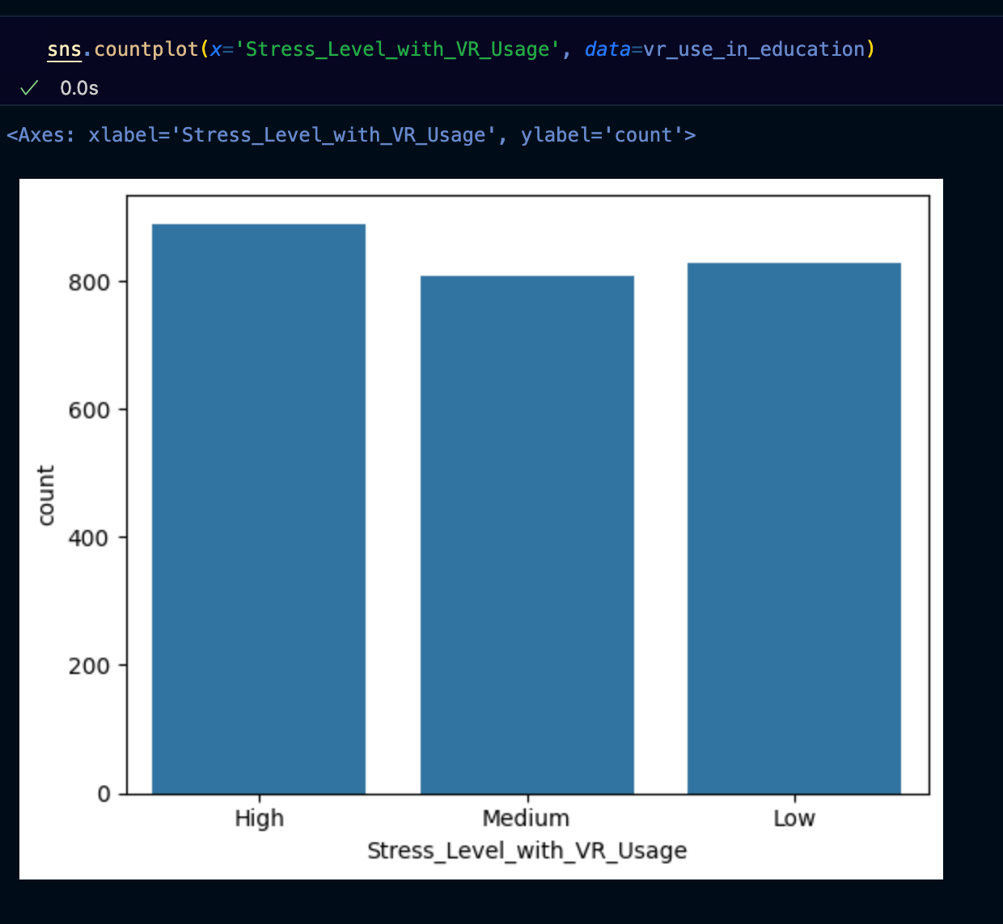

Slide 27
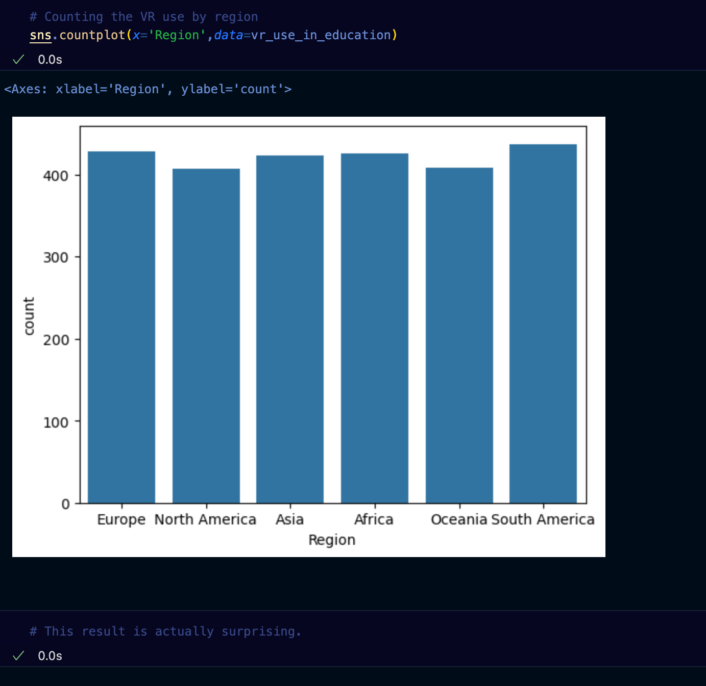

Slide 28
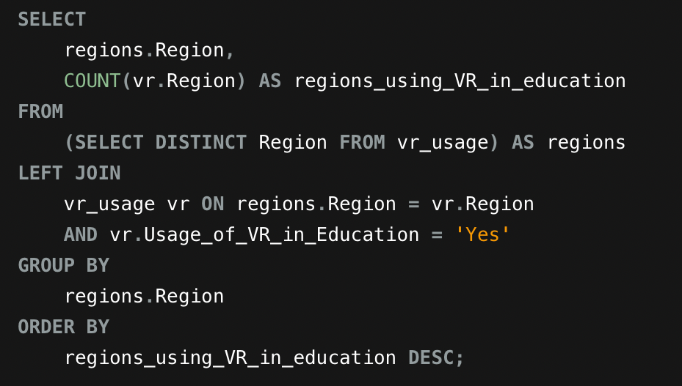
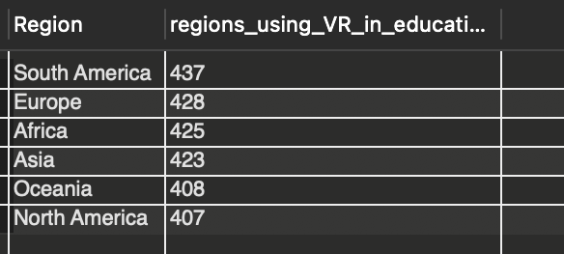
Business Questions
Question 01: What’s the global (geographical) distribution of VR usage in education? Where is VR used the most for educational purposes?

Slide 29
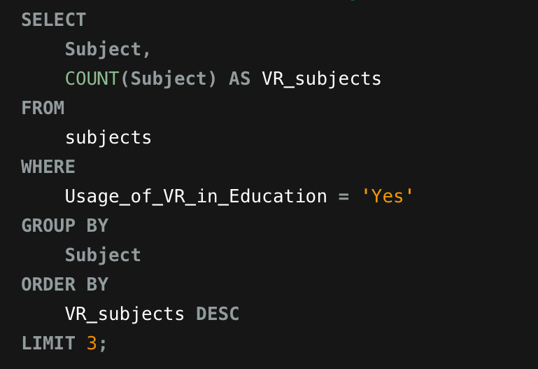
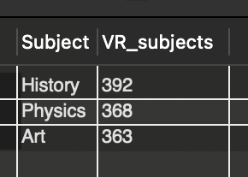
Business Questions
Question 02: Is there a subject for which VR is used the most or can be best applied for? Name the top 3 subjects for VR usage.

Slide 30
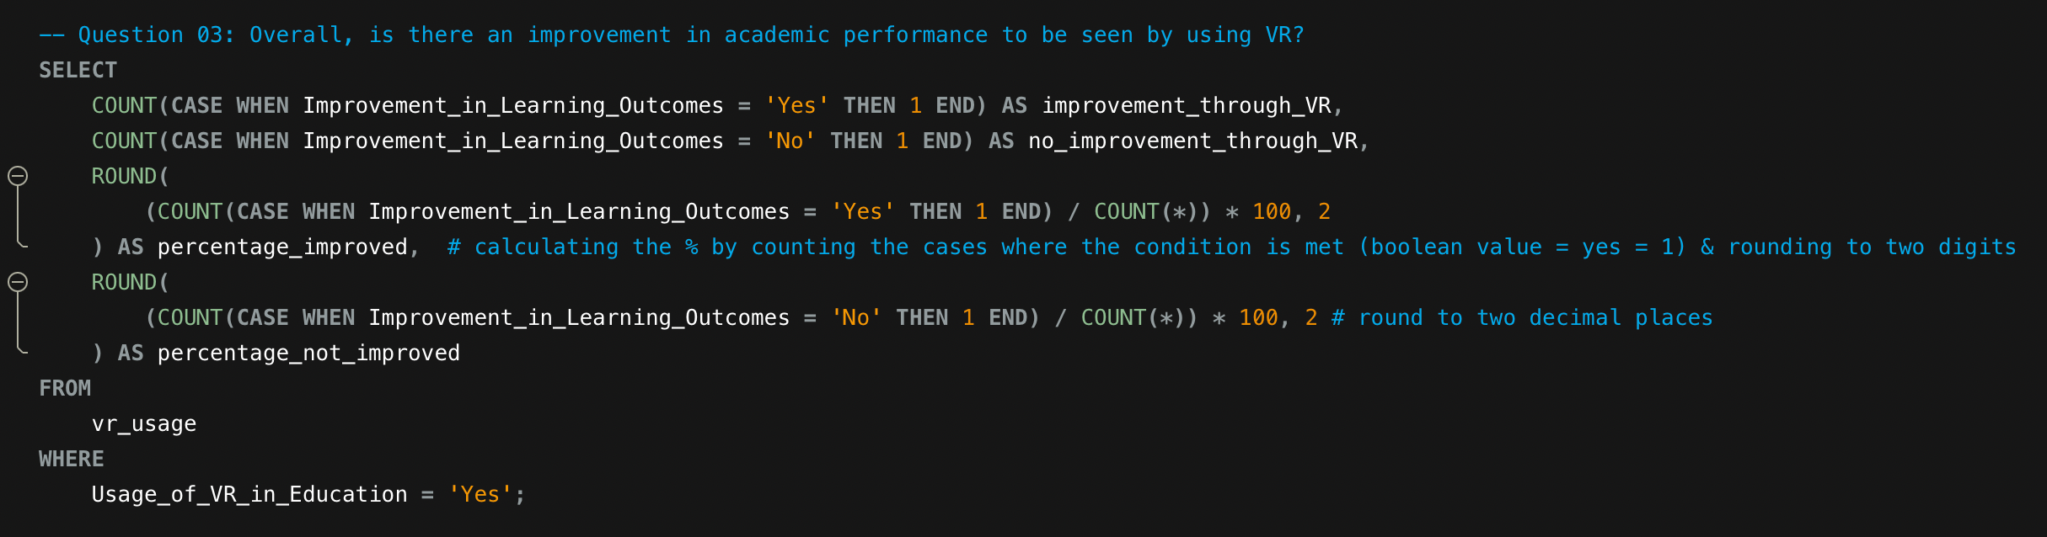
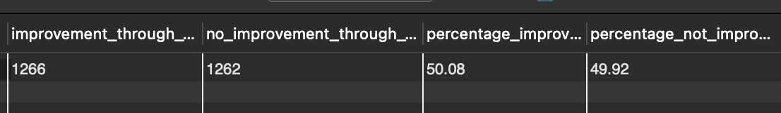
Business Questions
Question 03: Overall, is there an improvement in academic performance to be seen by using VR?

Slide 31
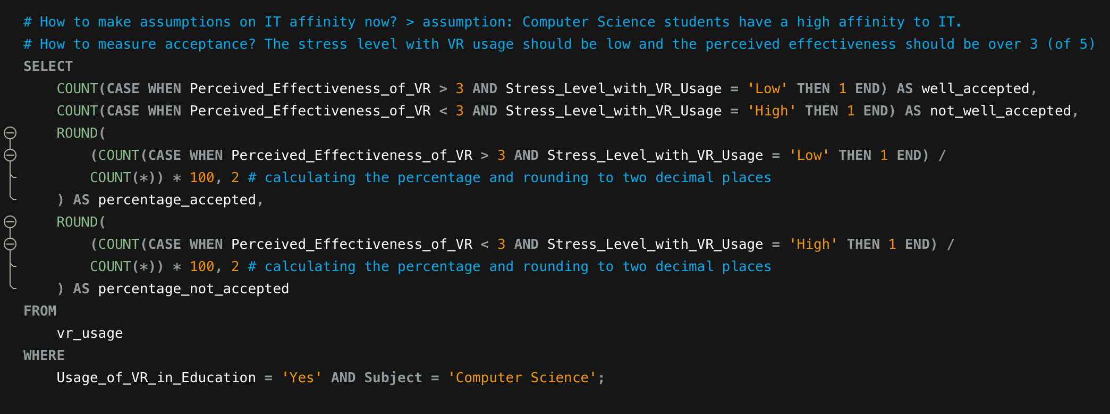
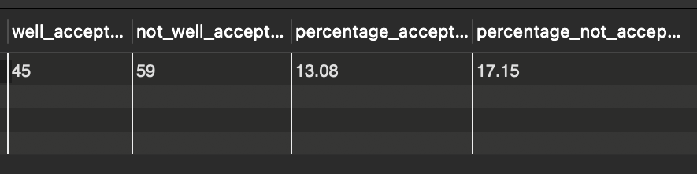
Business Questions
Question 04: Is there a relation between the level of improvement in academic performance and students’ IT affinity?

Slide 32
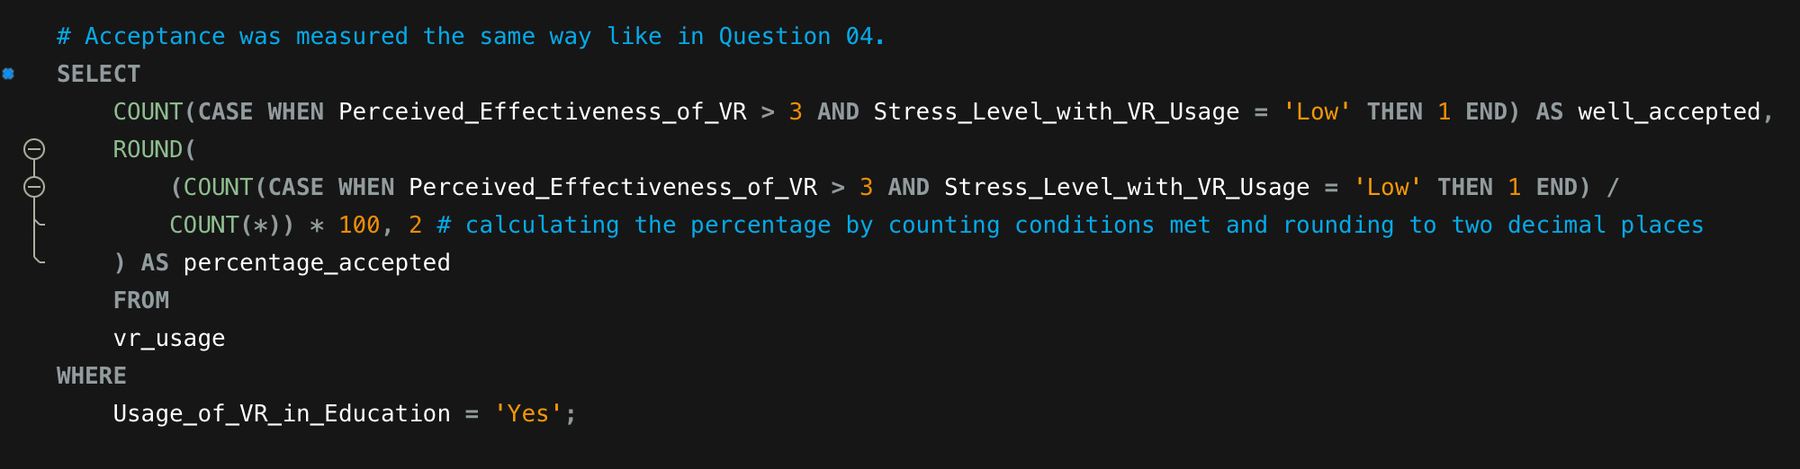
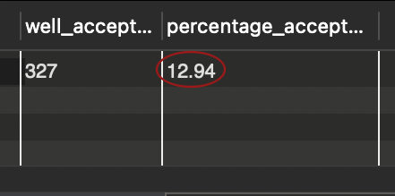
Business Questions
Question 05: What is the overall acceptance rate of VR in students?

Slide 33
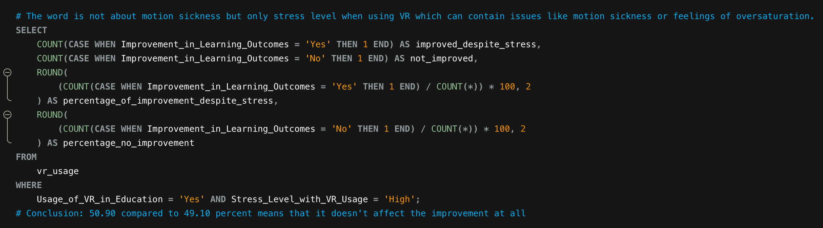
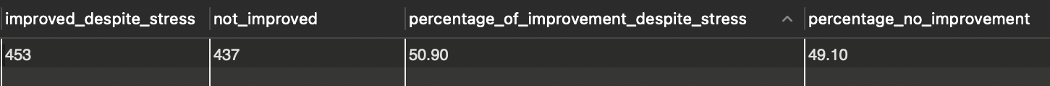
Business Questions
Question 06: How many students experience issues like motion sickness when using VR and how does it affect the improvement of academic performance?

Slide 34
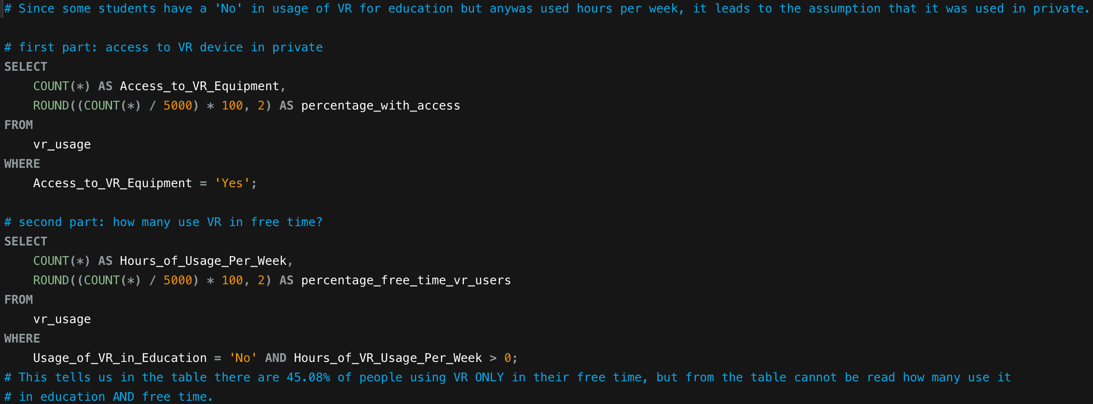
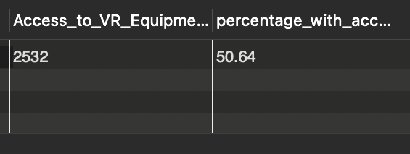
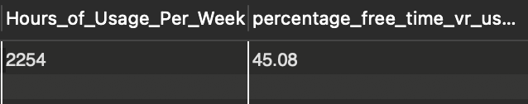
Business Questions
Question 07: How many students have access to a VR device in private and how many students use VR frequently in their free time for games etc.?

Slide 35
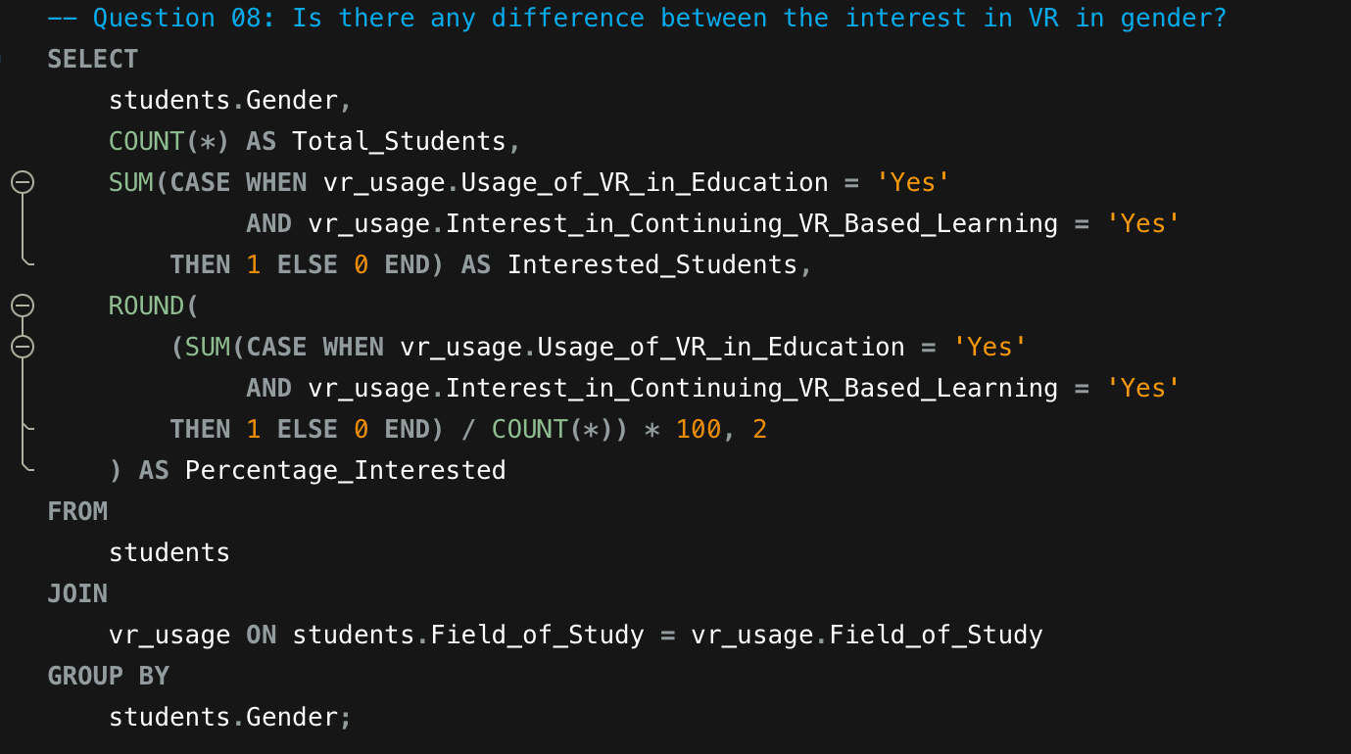
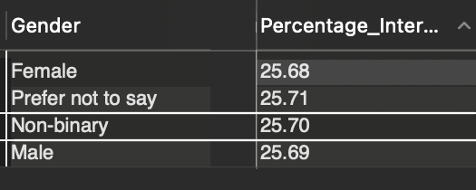
Business Questions
Question 08: Is there any difference between the interest in VR in gender?

Slide 36
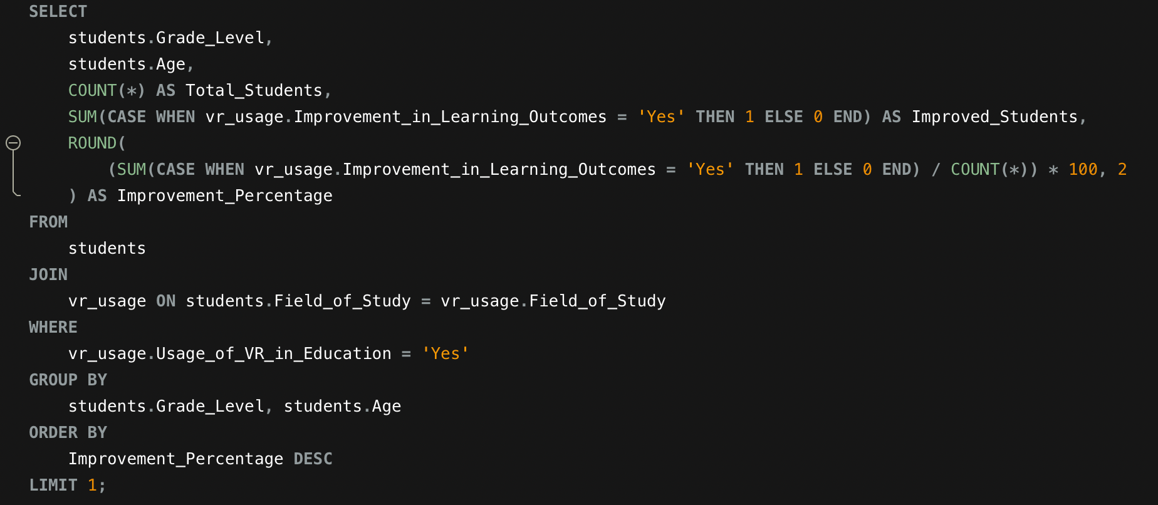
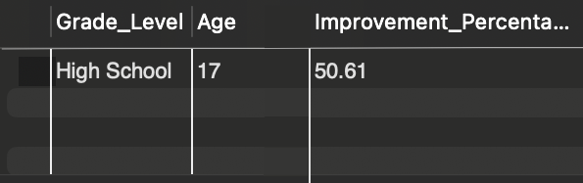
Business Questions
Question 09: At which grade level and age is VR the most effective in education?

Slide 37
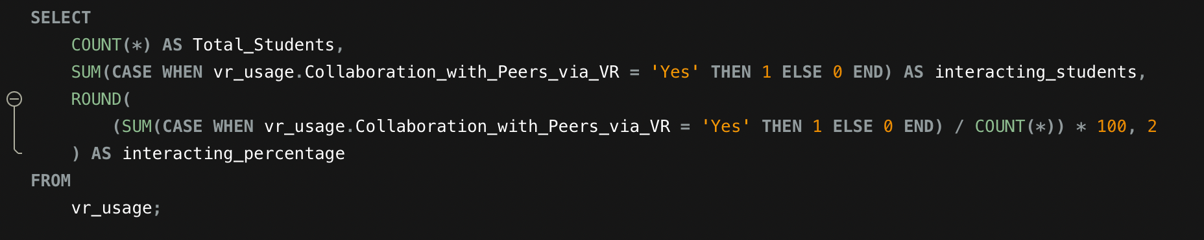
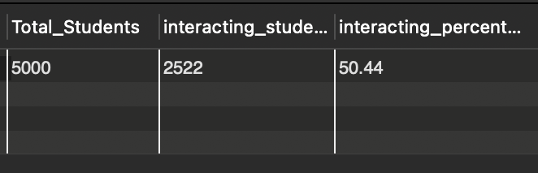
Business Questions
Question 10: Do students like to interact in VR or rather use it to learn things on their own?

Slide 38
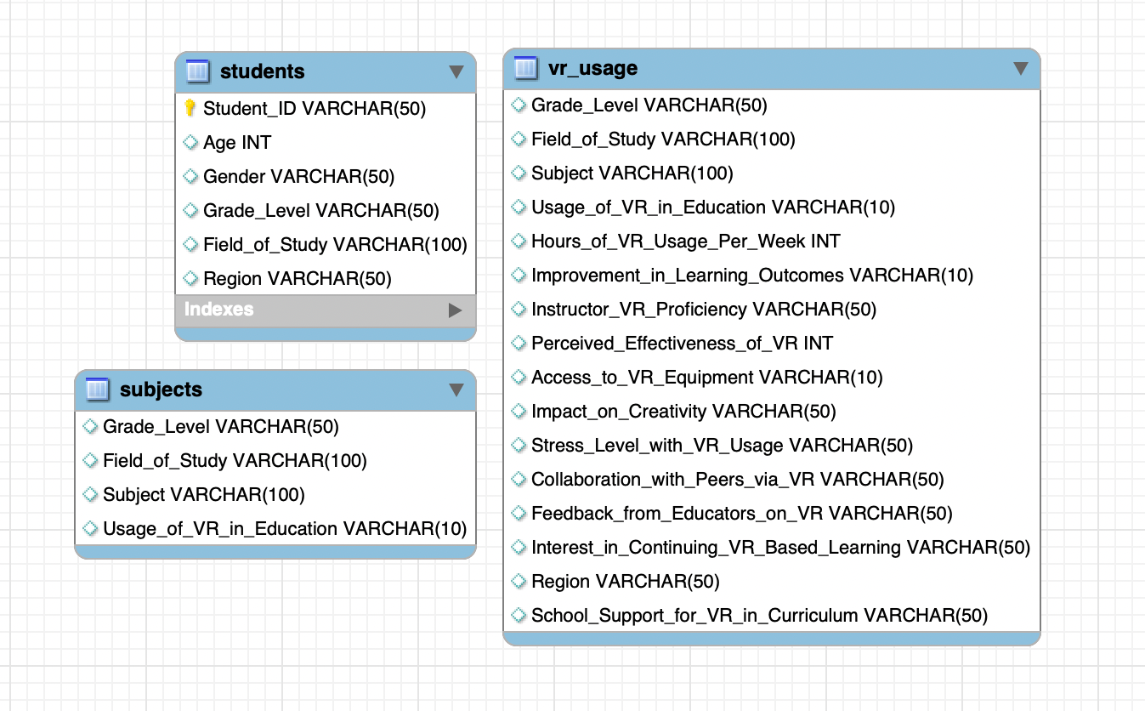
EER DIAGRAM

Slide 39

The OBSTACLES
Seeding the three tables in MySQL: due to access restrictions it wasn‘t possible to import the CSV-file into MySQL
Wanted to seed the table by writing insert statements for three tables containing 5000 rows
Used ChatGPT to write the prompts in sets of 20 or 50
Only inserted 500 values since I thought it would sufficiently approach the result you‘d get by having inserted 5000 → it didn‘t.
Had issues deleting everything again, then created a new database, the tables and seeded them via Python
Found out there was a problem when joining my tables students and vr_usage because the values always got impossibly high

Slide 40
The CONCLUSION
I chose the Dataset since the topic really interested me but immediately saw the dataset was very clean. So I investigated a lot and found out the data doesn‘t seem to be actual data from studies since the values are too evenly distributed and unrealistic
Business questions were a bit hard to answer but possible, the outcome is useless due to the dummy data from the data set

